Slide 1
Our Class Graph
Do Now: Clone this lecture’s repository and open the Jupyter notebook

Slide 2
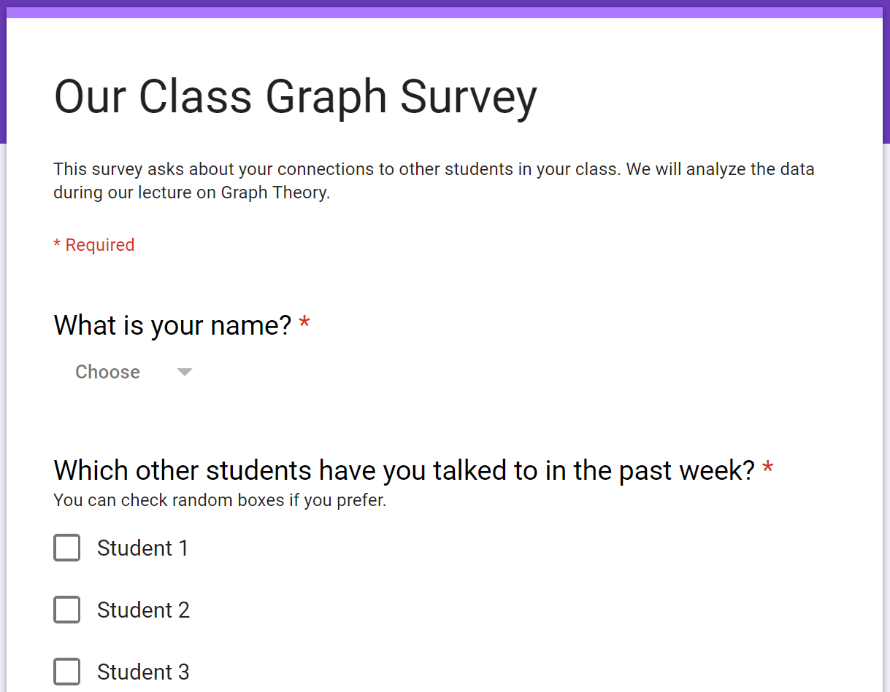

Do you all talk to each other?
Notes:
Here is one idea for how to present this activity to the class: You, as the teacher of this class, want to learn how well connected the class is. Developing strong collaborative relationships within the class is important to you. This survey is a chance for you to learn without having to ask everyone, and it makes a great activity to boot.

Slide 3
Today’s Learning Goals
Use NetworkX to visualize and analyze a network
Describe networks using concepts such as connectivity, centrality and communities
Use descriptive information about graphs to make real-world recommendations
Notes:
Goals: This is a flipped lesson, so students should already know the basics of network analysis and NetworkX. This lesson is focused on applying those skills to a real-world network, interpreting the results, and using them to make recommendations.

Slide 4
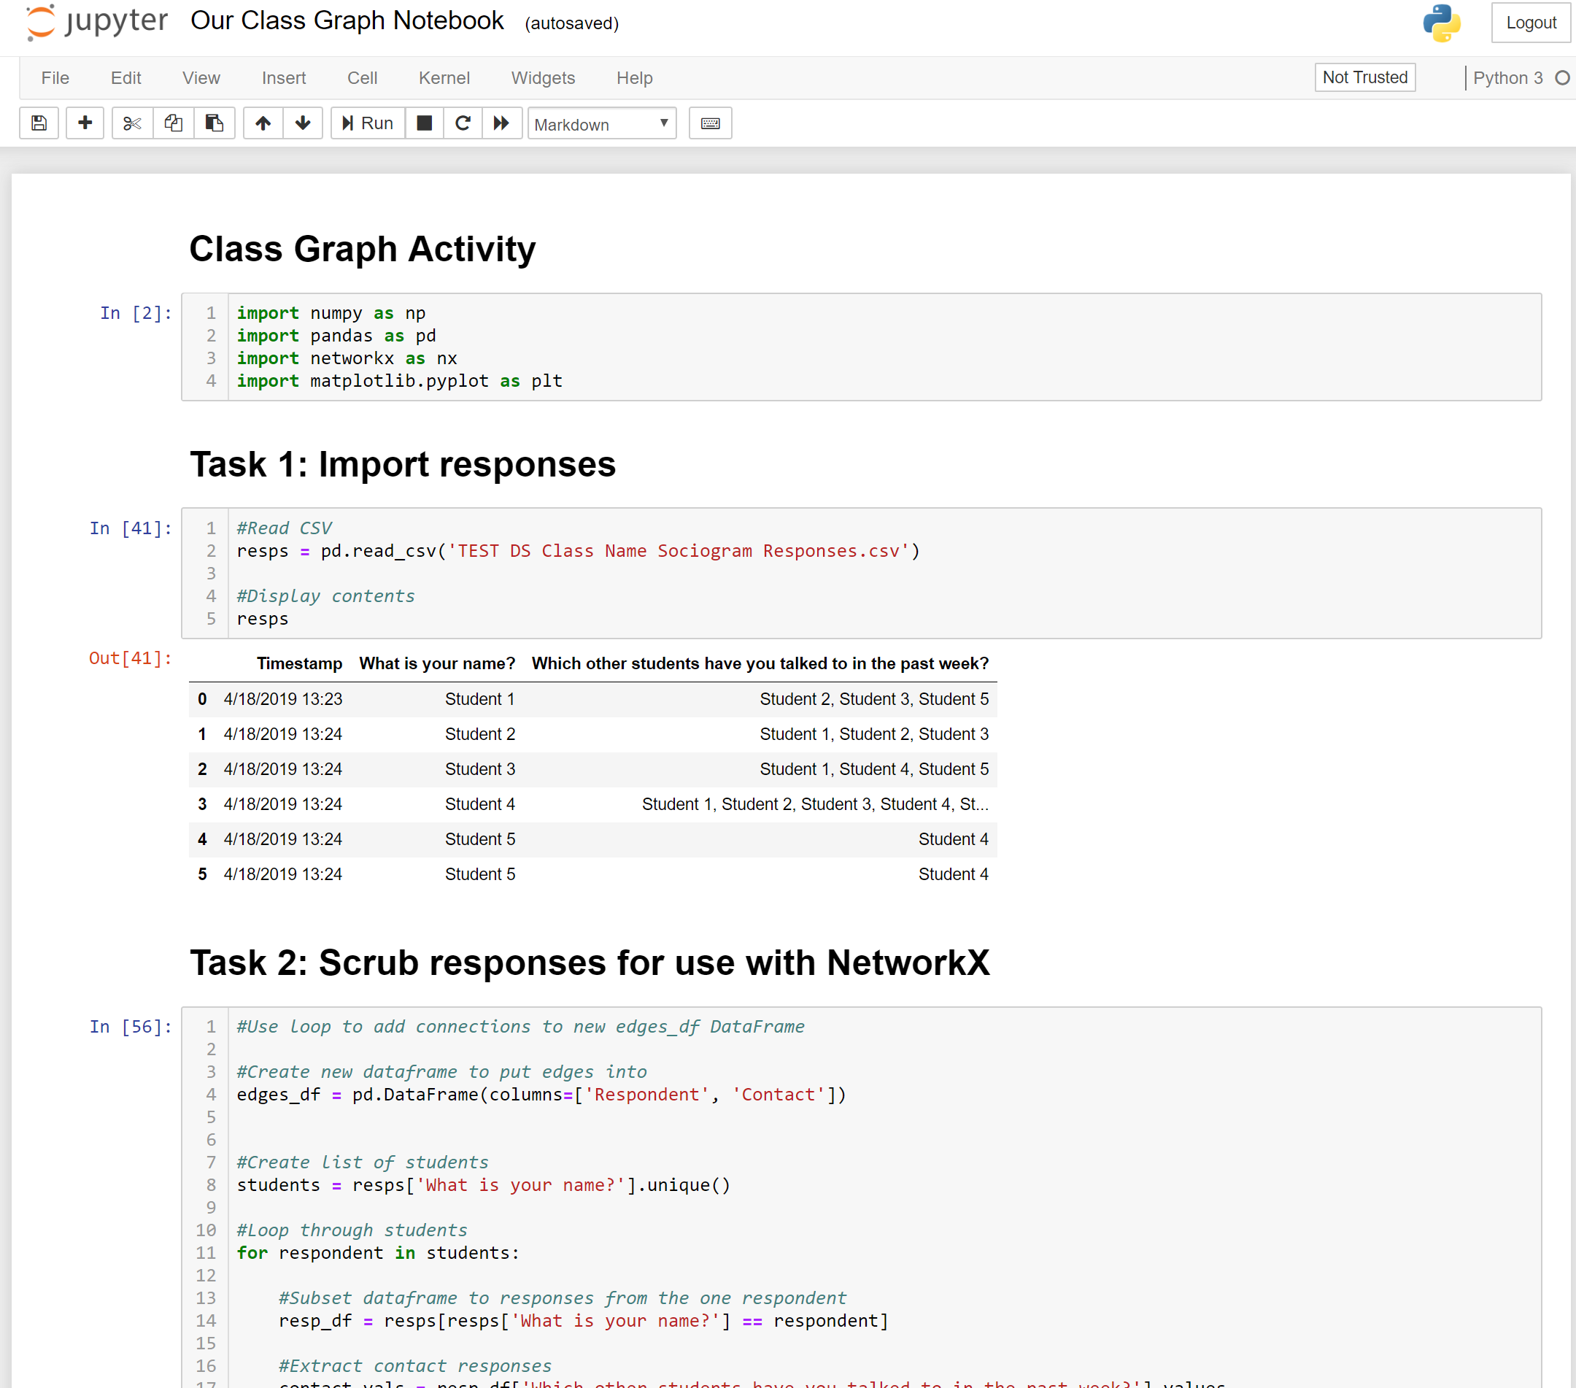
Today’s Activity
Activity Goal: Make recommendations to me, as your teacher, about how to improve class cohesion
Work in pairs to analyze our class’s responses using the Jupyter notebook (35 min)
Pairs will join up to make groups of four to discuss answers and pick one to share (15 min)
Each group will share with the class one recommendation and supporting findings (20 min)
Whole-class discussion about the activity (10 min)
Notes:
Activity: Walk through the steps for todays activity. Feel free to add in additional guidance for any of these steps if you feel it would be helpful for your class, such as assigning pairs or providing structure for sharing answers.

Slide 5
Notes About Today’s Activity
I have no idea what our class network actually looks like – it could be weird
You have a fair amount of leeway to interpret/answer some of the questions in the notebook. Feel free to be creative!
If you get stuck, there are hints at the bottom of the notebook
Task 5 in the Jupyter Notebook asks you to make recommendations to me for improving class cohesion. I promise to listen to your recommendations, but not necessarily to use them
Notes:
Notes: This is your chance to head off potential issues. Warn them that the graph may have an unusual structure that will make it hard to interpret any graph metrics. Also warn them that some of the questions in the notebook are intentionally ambiguous to prompt discussion within groups about how best to approach the problem. Tell them that they may find it helpful to keep in mind the end goal, which is to make recommendations to you about class cohesion.

Slide 6
Work in pairs to analyze our class’s responses using the Jupyter notebook (35 min)
We have given you code to import and scrub the responses
There are hints at the bottom of the notebook
Raise your hand if you need assistance
Notes:
Put up this slide when you’re ready for students to start working

Slide 7
Pairs join to make groups of four to discuss answers and prepare to share (15 min)
In the next step of this activity, each group will present one recommendation and the findings that support that recommendation
You will have ~1 minute to share, and the class will have ~3 minutes to ask questions
If you want to show text or a visual to the class, please email/Slack it to me
Notes:
Put up this slide when you’re ready to transition to group work. Reinforce the point that you want both the recommendation and the findings that support it. You can let them know that the timing is not strict.

Slide 8
Each group will share with the class one recommendation and supporting findings
You will have ~1 minute to share
The class will have ~3 minutes to ask questions
Notes:
Put up this slide when you’re ready to have groups share out. In total, this section should take about 20 minutes

Slide 9
Discussion
Did you see any overarching themes in our findings or recommendations?
What were some limitations to our analysis? How might you change the survey or analysis to address them?
Could this class graph be useful for anything other than recommendations for me?
Do you think I should actually act on any of your recommendations? Why or why not?
Notes:
Feel free to facilitate this whole group discussion however you like. I recommend going through each question, asking the question out loud to the class, solicit responses, and ask the class what they think of those responses.

